Slide 1

Cloud Based Phone System Asterisk Server
Cloud Based IP-PBX phone system using VoIP Technology

Slide 2
Introduction
What is a cloud-based phone system?
A cloud-based phone system, or cloud phone, is a phone service that allows you to make calls over the internet rather than over a traditional analog phone line that uses copper wires or optical fibers to make a connection. Cloud phones are hosted in one or more off-site secure data centers.

Slide 3
Problem Statement
Nowadays the EPBX (Electronic Phone Branch Exchange) system is used in many business organizations, Hotels, and Institutions etc. for voice communication.
Now we are replacing the EPBX system with Cloud based IP-PBX phone system for the use of voice communication in business enterprises, Educational Institutions etc.

Slide 4

The benefit of using cloud-based phone system is –
It does not require a lot of hardware.
Work with different devices like Android, Windows, Linux and VoIP or IP based phones. It easily supports remote work.
It keeps logs into the cloud server.
New services and features are added easily.

Slide 5

Technology Used
VoIP
A VoIP phone is a hardware - or software-based telephone designed to use voice over Internet Protocol (VoIP) technology to send and receive phone calls over an IP network.
Asterisk Server
Asterisk is an open-source framework for building communications applications.
Asterisk turns an ordinary computer into a communications server. Asterisk powers IP PBX systems, VoIP gateways, conference servers and other custom solutions.

Slide 6
Cloud Based Ubuntu Server
Ubuntu Server is a server operating system, developed by Canonical and open-source programmers around the world, that works with nearly any hardware or virtualization platform.
SIP
SIP stands for Session Initiation Protocol. The Session Initiation Protocol (SIP) is a signaling protocol used for initiating, maintaining, and terminating communication sessions that include voice, video, and messaging applications.

Slide 7
Methodology
In the proposed system we are implenting the cloud based phone system using Asterisk Server.
-> First we installed the Linux based Ubuntu 20.02 server on the cloud.
-> After that we have to install the Asterisk in our Ubuntu Server
-> After configuring the Asterisk Server we have write our own dial plans.
-> After implementing the dial plans and extensions file we to connect our softphone or VoIP phones with our server using the IP Address.

Slide 8
Flowchart

Slide 9
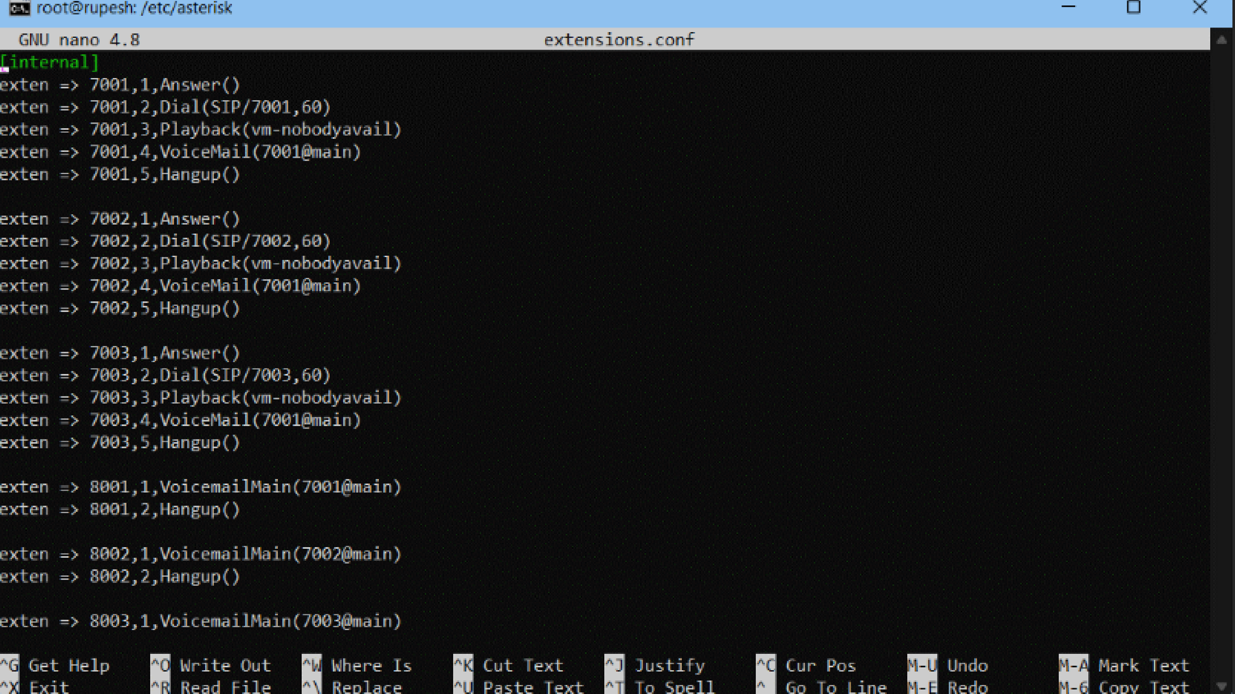

Slide 10
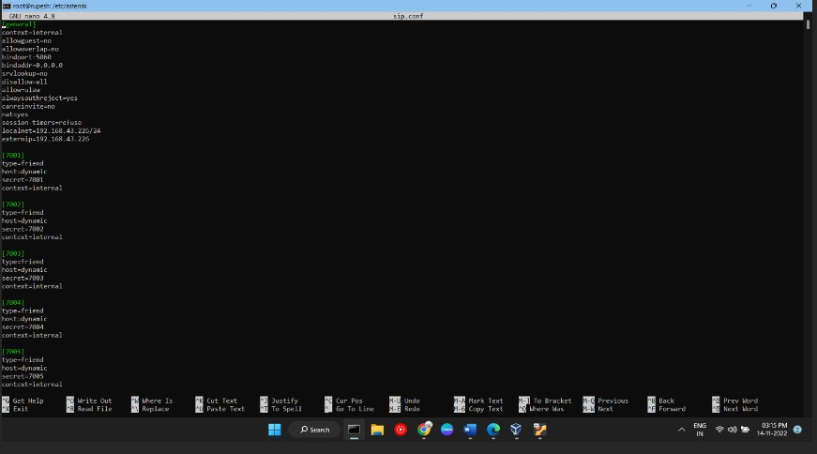

Slide 11
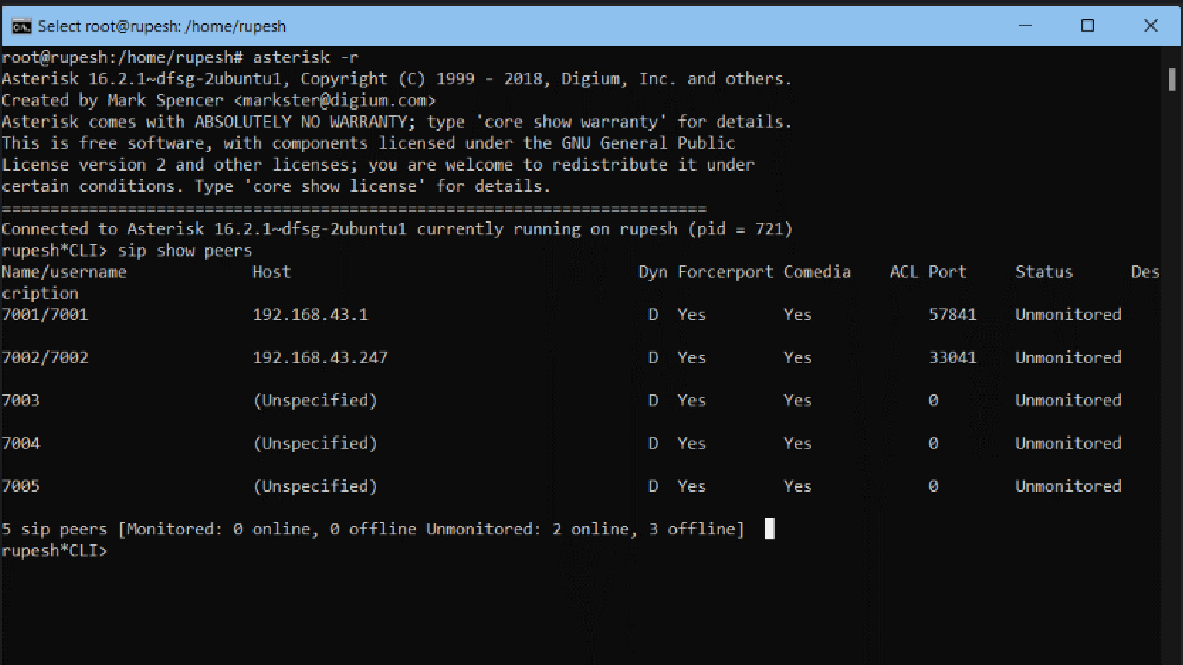

Slide 12
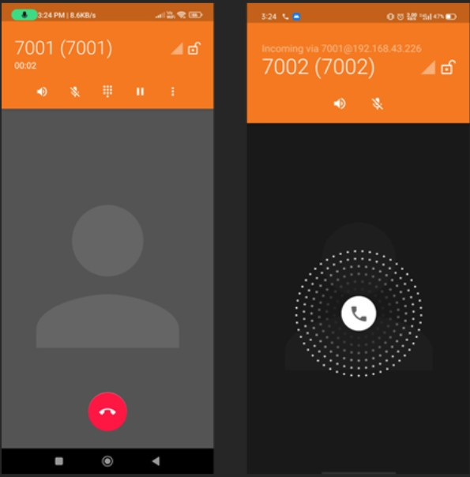

Slide 13
Conclusion
This research project aimed to create communication System, to enhance the voice communication inside any organization. The previous system uses Raspberry Pi device in different research papers to implement the Asterisk PBX system. That system causes a sort of delay Because the system Used the Raspberry pi which comes with a limited computing Resources. But now we are replacing the Raspberry Pi device with the Cloud Server because in cloud we have a suitable number of resources available.
The research project was particularly challenging, especially because the system is Linux based. The result was satisfying since the main objectives was realized.

